Slide 1


Slide 2

Robust $H_{\text{∞}}$Static Output Feedback for TCP-AQM Routers
By
Muhammad Muaz Rauf
Muhammad Danish Nisar

Slide 3
Contents
Introduction: The challenge of Internet Congestion & AQM.
Problem Statement: Why Static Output Feedback (SOF)?
System Modeling: Nonlinear vs. Linearized TCP/AQM models.
Theoretical Framework: LMI Optimization for Case 3 (h=d).
Implementation: Simulation parameters and setup.
Reproduced Results: Comparison of Queue, Window Size, and RTT.
Conclusion: Summary of findings.

Slide 4
Introduction & Motivation
The Context:
  Exponential growth in internet traffic necessitates robust congestion control mechanisms4.
  Network parameters like Round-Trip Time (RTT) and Link Capacity fluctuate constantly5.
The Problem with Traditional Methods:
  Algorithms like Random Early Detection (RED) rely on heuristic tuning.
  They often suffer from parameter tuning difficulties and oscillatory responses.
The Robust Control Solution:
  Modern H∞ synthesis offers mathematically guaranteed robustness against these uncertainties
Notes:
As internet traffic grows, congestion becomes a critical issue. Traditional algorithms like Random Early Detection, or RED, often fail because they are hard to tune and unstable under varying loads. Our project explores a robust control method that mathematically guarantees stability despite these variations.

Slide 5

Problem Statement
The Limitation of Current Robust Controllers:
  Many existing H ∞ controllers require Full State Feedback.
  Requirement: Measurement of TCP Window Size (W) and global RTT ($τ$).
  Reality: Routers can only easily measure their own Queue Length (q) .
The Proposed Solution:
  Static Output Feedback (SOF)Uses only available measurements (Queue Length).
  Avoids complex observers (like Kalman filters) which are computationally expensive for high-speed routers.
Notes:
The main problem with existing robust controllers is that they need data the router doesn't have, like the window size of every user. Obtaining this is impractical. Our solution uses Static Output Feedback, which relies solely on the queue length—a metric the router already possesses—making it far more practical for real-world implementation.

Slide 6
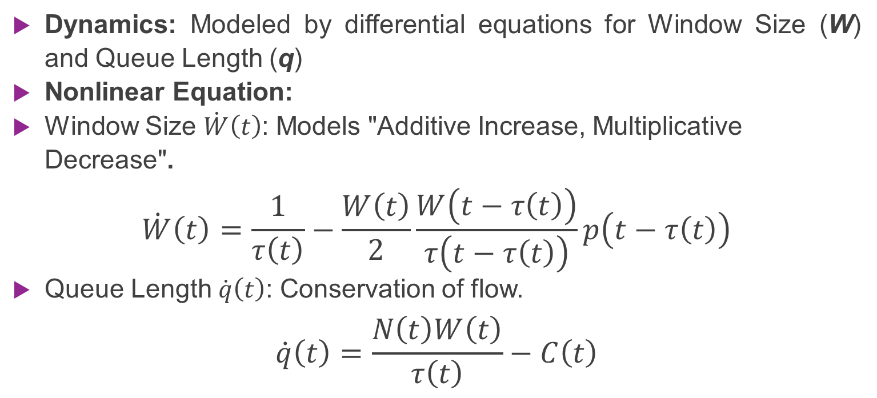
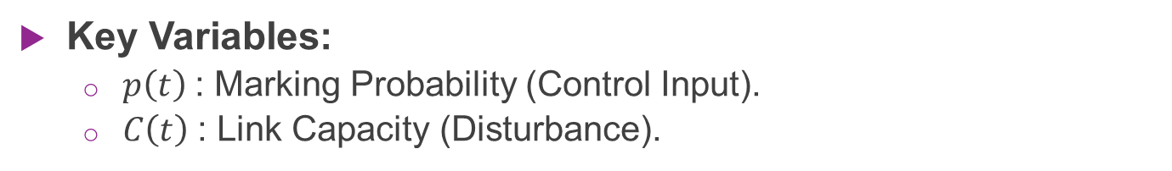
System Modeling (Nonlinear Fluid Model)
Dynamics: Modeled by differential equations for Window Size (W) and Queue Length (q)
Nonlinear Equation:
Window Size $\dot{W}\left(t\right)$: Models "Additive Increase, Multiplicative Decrease".
$$\dot{W}\left(t\right)=\frac{1}{τ\left(t\right)}−\frac{W\left(t\right)}{2}\frac{W\left(t−τ\left(t\right)\right)}{τ\left(t−τ\left(t\right)\right)}p\left(t−τ\left(t\right)\right)$$
Queue Length $\dot{q}\left(t\right)$: Conservation of flow.
$$\dot{q}\left(t\right)=\frac{N\left(t\right)W\left(t\right)}{τ\left(t\right)}−C\left(t\right)$$
Key Variables:
  $p\left(t\right)$: Marking Probability (Control Input).
  $C\left(t\right)$: Link Capacity (Disturbance).
Notes:
We started with the nonlinear fluid-flow model. The first equation represents TCP's additive increase and multiplicative decrease behavior. The second equation simply tracks the queue length based on incoming traffic versus the link's outgoing capacity

Slide 7

Linearization & State-Space Model
Linearization:
  Performed around a stable operating point ($W_{0}$, $q_{0}$, $p_{0}$).
  Defines small-signal deviations: $δW\left(t\right)$, $δq\left(t\right)$, $δp\left(t\right)$.
State-Space Form:
$$\dot{x}\left(t\right)=Ax\left(t\right)+A_{d}x\left(t−d\right)+Bu\left(t−h\right)+Dω\left(t\right), z\left(t\right)=Lx\left(t\right), y\left(t\right)=Cx\left(t\right).$$
  State Vector: $x\left(t\right)=\left[\begin{matrix}δW\left(t\right) \\ δq\left(t\right)\end{matrix}\right]$
  Control Input: $u\left(t\right)=δp\left(t\right)$
  Disturbance Vector: $ω\left(t\right)=\left[\begin{matrix}δC\left(t\right) \\ δC\left(t−τ_{0}\right)\end{matrix}\right]$
Delays:
  d = State delay (RTT).:
  h = Input delay.
Notes:
To apply linear control theory, we linearized the system around an equilibrium point. This gives us a state-space model that accounts for the deviations in window size and queue length. Crucially, this model includes terms for both state delays and input delays.

Slide 8

Linearized State-Space Model
Full state linearized Equations (Matrix from)
$\left[\begin{matrix}δ\dot{W}\left(t\right) \\ δ\dot{q}\left(t\right)\end{matrix}\right]=\underset{A}{\underset{⏟}{\left[\begin{matrix}−\frac{N}{τ_{0}^{2}C_{0}} & −\frac{1}{τ_{0}^{2}C_{0}} \\ \frac{N}{τ_{0}} & −\frac{1}{τ_{0}}\end{matrix}\right]}}\left[\begin{matrix}δW\left(t\right) \\ δq\left(t\right)\end{matrix}\right]+\underset{A_{d}}{\underset{⏟}{\left[\begin{matrix}−\frac{N}{τ_{0}^{2}C_{0}} & \frac{1}{τ_{0}^{2}C_{0}} \\ 0 & 0\end{matrix}\right]}}\left[\begin{matrix}δW\left(t−τ_{0}\right) \\ δq\left(t−τ_{0}\right)\end{matrix}\right]+\underset{B}{\underset{⏟}{\left[\begin{matrix}−\frac{τ_{0}C_{0}^{2}}{2N^{2}} \\ 0\end{matrix}\right]}}δp\left(t−τ_{0}\right)+\underset{D}{\underset{⏟}{\left[\begin{matrix}\frac{τ_{0}−T_{p}}{τ_{0}^{2}C_{0}} & −\frac{τ_{0}−T_{p}}{τ_{0}^{2}C_{0}} \\ −\frac{T_{p}}{τ_{0}} & 0\end{matrix}\right]}}\left[\begin{matrix}δC\left(t\right) \\ δC\left(t−τ_{0}\right)\end{matrix}\right]$
Now we have three cases in this model
  Case 1: input delay h=0 (Theorem 1; LMIs (6),(7)).
  Case 2: input delay h≠d, h>0 (Theorem 2; LMI (16)).
  Case 3: h=d special-case simplification (Eq. (21)).
Moving forward our focus will be on case 3 as it is the most realistic one.

Slide 9
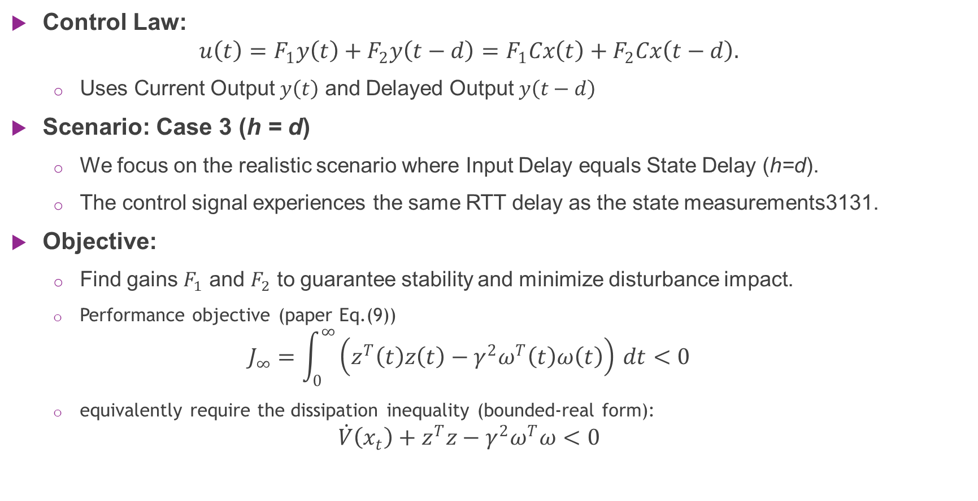
Controller Design (Case 3)
Control Law:
  $$u\left(t\right)=F_{1}y\left(t\right)+F_{2}y\left(t−d\right)=F_{1}Cx\left(t\right)+F_{2}Cx\left(t−d\right).$$
  Uses Current Output $y\left(t\right)$ and Delayed Output $y\left(t−d\right)$
Scenario: Case 3 (h = d)
  We focus on the realistic scenario where Input Delay equals State Delay (h=d).
  The control signal experiences the same RTT delay as the state measurements3131.
Objective:
  Find gains $F_{1}$ and $F_{2}$ to guarantee stability and minimize disturbance impact.
  Performance objective (paper Eq.(9))
  $$J_{∞}=\int_{0}^{∞}{\left(z^{T}\left(t\right)z\left(t\right)−γ^{2}ω^{T}\left(t\right)ω\left(t\right)\right)} dt<0$$
  equivalently require the dissipation inequality (bounded-real form):
  $$\dot{V}\left(x_{t}\right)+z^{T}z−γ^{2}ω^{T}ω<0$$
Notes:
We focused our reproduction on 'Case 3', where the input delay matches the state delay. Our controller is a Static Output Feedback type, meaning it calculates the control signal using only the current queue length and the queue length from one RTT ago

Slide 10
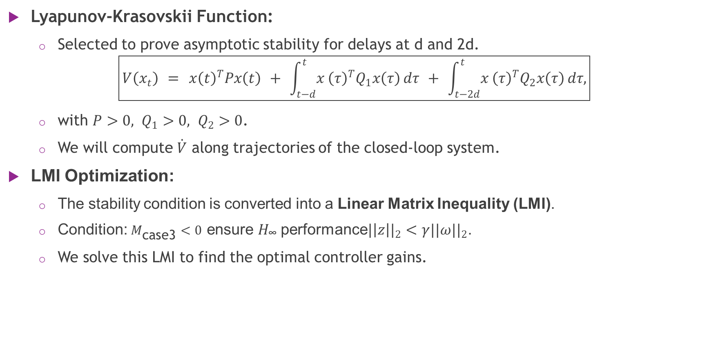
Theoretical Framework (LMI)
Lyapunov-Krasovskii Function:
  Selected to prove asymptotic stability for delays at d and 2d.
$$\boxed{V\left(x_{t}\right) = x{\left(t\right)}^{T}Px\left(t\right) + \int_{t−d}^{t}{x}{\left(τ\right)}^{T}Q_{1}x\left(τ\right) dτ + \int_{t−2d}^{t}{x}{\left(τ\right)}^{T}Q_{2}x\left(τ\right) dτ,}$$
  with $P>0, Q_{1}>0, Q_{2}>0$.
  We will compute $\dot{V}$ along trajectories of the closed-loop system.
LMI Optimization:
  The stability condition is converted into a Linear Matrix Inequality (LMI).
  Condition: $M_{\text{case}\text{3}}<0$ ensure $H_{\text{∞}}$ performance${|\left|z\right||}_{2}<γ{||ω||}_{2}$.
  We solve this LMI to find the optimal controller gains.
Notes:
To guarantee stability, we used a Lyapunov-Krasovskii functional. By manipulating this functional, we derived a Linear Matrix Inequality. Solving this LMI gives us the controller gains that ensure the system remains stable and rejects disturbances effectively

Slide 11
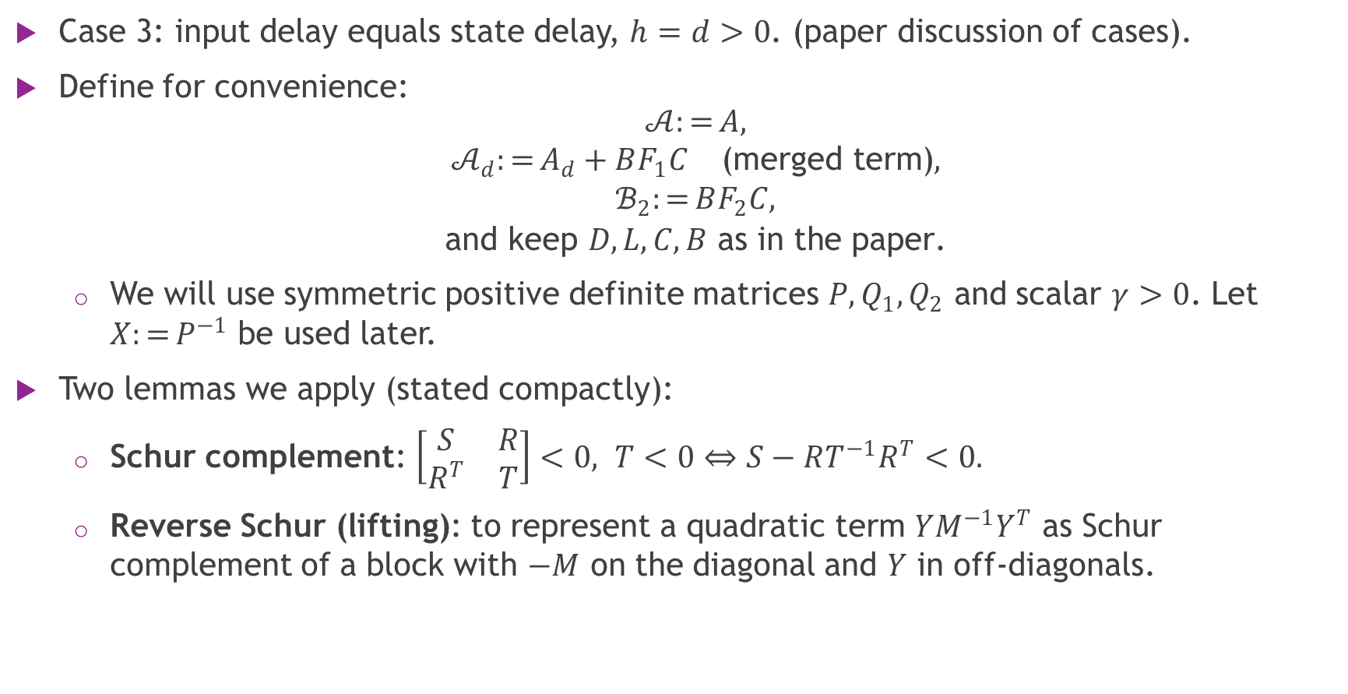
Case 3 (Lemmas used)
Case 3: input delay equals state delay, $h=d>0$. (paper discussion of cases).
Define for convenience:
$$\begin{matrix} & 𝒜:=A, \\ & 𝒜_{d}:=A_{d}+BF_{1}C \text{(}\text{merged} \text{term}\text{)}, \\ & ℬ_{2}:=BF_{2}C, \\ & \text{and} \text{keep} D,L,C,B \text{as} \text{in} \text{the} \text{paper}\text{.}\end{matrix}$$
  We will use symmetric positive definite matrices $P,Q_{1},Q_{2}$ and scalar $γ>0$. Let $X:=P^{−1}$ be used later.
Two lemmas we apply (stated compactly):
  Schur complement: $\left[\begin{matrix}S & R \\ R^{T} & T\end{matrix}\right]<0, T<0⇔S−RT^{−1}R^{T}<0.$
  Reverse Schur (lifting): to represent a quadratic term $YM^{−1}Y^{T}$ as Schur complement of a block with $−M$ on the diagonal and $Y$ in off-diagonals.
Notes:
To guarantee stability, we used a Lyapunov-Krasovskii functional. By manipulating this functional, we derived a Linear Matrix Inequality. Solving this LMI gives us the controller gains that ensure the system remains stable and rejects disturbances effectively

Slide 12

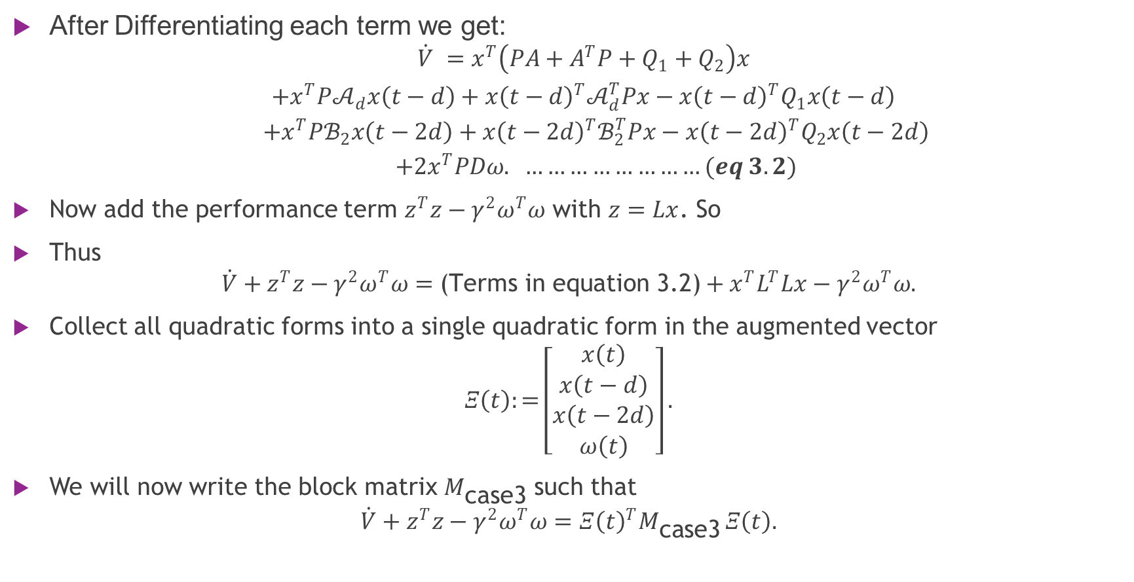
Computing $\dot{V}$ along trajectories of the closed-loop system
After Differentiating each term we get:
$$\begin{matrix} & \dot{V} =x^{T}\left(PA+A^{T}P+Q_{1}+Q_{2}\right)x \\ & +x^{T}P𝒜_{d}x\left(t−d\right)+x{\left(t−d\right)}^{T}𝒜_{d}^{T}Px−x{\left(t−d\right)}^{T}Q_{1}x\left(t−d\right) \\ & +x^{T}Pℬ_{2}x\left(t−2d\right)+x{\left(t−2d\right)}^{T}ℬ_{2}^{T}Px−x{\left(t−2d\right)}^{T}Q_{2}x\left(t−2d\right) \\ & +2x^{T}PDω. ……………………(eq 3.2)\end{matrix}$$
Now add the performance term $z^{T}z−γ^{2}ω^{T}ω$ with $z=Lx$. So
Thus
$$\dot{V}+z^{T}z−γ^{2}ω^{T}ω=\text{(}\text{Terms} \text{in} \text{equation}\text{ 3.2)}+x^{T}L^{T}Lx−γ^{2}ω^{T}ω.$$
Collect all quadratic forms into a single quadratic form in the augmented vector
$$Ξ\left(t\right):=\left[\begin{matrix}x\left(t\right) \\ x\left(t−d\right) \\ x\left(t−2d\right) \\ ω\left(t\right)\end{matrix}\right].$$
We will now write the block matrix $M_{\text{case}\text{3}}$ such that
$$\dot{V}+z^{T}z−γ^{2}ω^{T}ω=Ξ{\left(t\right)}^{T}M_{\text{case}\text{3}} Ξ\left(t\right).$$

Slide 13

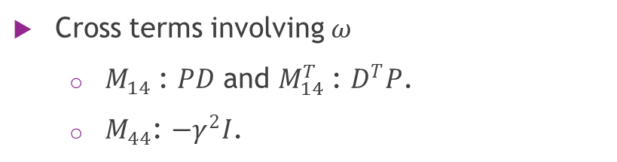

Build the block matrix $M_{\text{case}\text{3}}$ (1/2)
Consider $M_{\text{case}\text{3}}$ matrix as
$$\boxed{M_{\text{case}\text{3}}=\left[\begin{matrix}M_{11} & M_{12} & M_{13} & M_{14} \\ M_{12}^{T} & M_{22} & 0 & 0 \\ M_{13}^{T} & 0 & M_{33} & 0 \\ M_{14}^{T} & 0 & 0 & M_{44}\end{matrix}\right].}$$
For $M_{11}$
Coefficient for $x{\left(t\right)}^{T}\left(⋅\right)x\left(t\right)$ (block (1,1)) : $PA+A^{T}P+Q_{1}+Q_{2}+L^{T}L.$
For $M_{12}$ and $M_{12}^{T}$
Cross term between $x\left(t\right)$ and $x\left(t−d\right)$ : $P𝒜_{d}.$
For $M_{13}$ and $M_{13}^{T}$
Cross term between $x\left(t\right)$ and $x\left(t−2d\right)$: $Pℬ_{2}.$
Diagonal blocks for delayed states:
  $M_{22}$: $−Q_{1}$.
  $M_{33}$ : $−Q_{2}$.
Cross terms involving $ω$
  $M_{14}$: $PD$ and $M_{14}^{T}$: $D^{T}P$.
  $M_{44}$: $−γ^{2}I$.

Slide 14

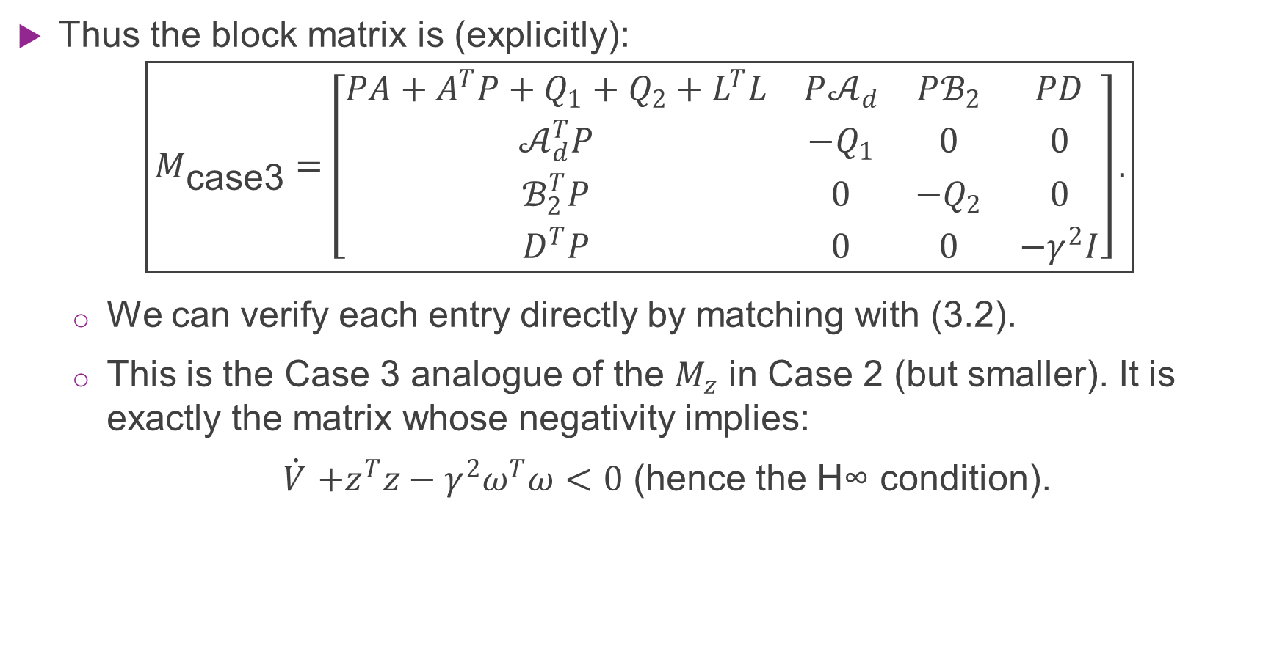
Build the block matrix $M_{\text{case}\text{3}}$ (2/2)
Thus the block matrix is (explicitly):
$$\boxed{M_{\text{case}\text{3}}=\left[\begin{matrix}PA+A^{T}P+Q_{1}+Q_{2}+L^{T}L & P𝒜_{d} & Pℬ_{2} & PD \\ 𝒜_{d}^{T}P & −Q_{1} & 0 & 0 \\ ℬ_{2}^{T}P & 0 & −Q_{2} & 0 \\ D^{T}P & 0 & 0 & −γ^{2}I\end{matrix}\right].}$$
  We can verify each entry directly by matching with (3.2).
  This is the Case 3 analogue of the $M_{z}$ in Case 2 (but smaller). It is exactly the matrix whose negativity implies:
  $\dot{V}$ $+z^{T}z−γ^{2}ω^{T}ω<0$ (hence the H∞ condition).

Slide 15
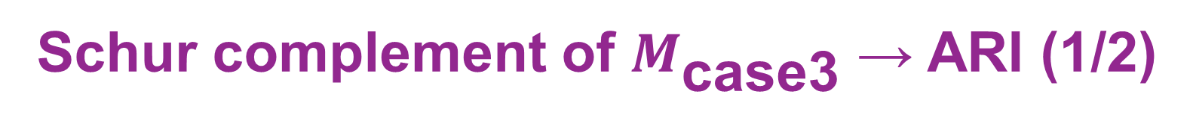
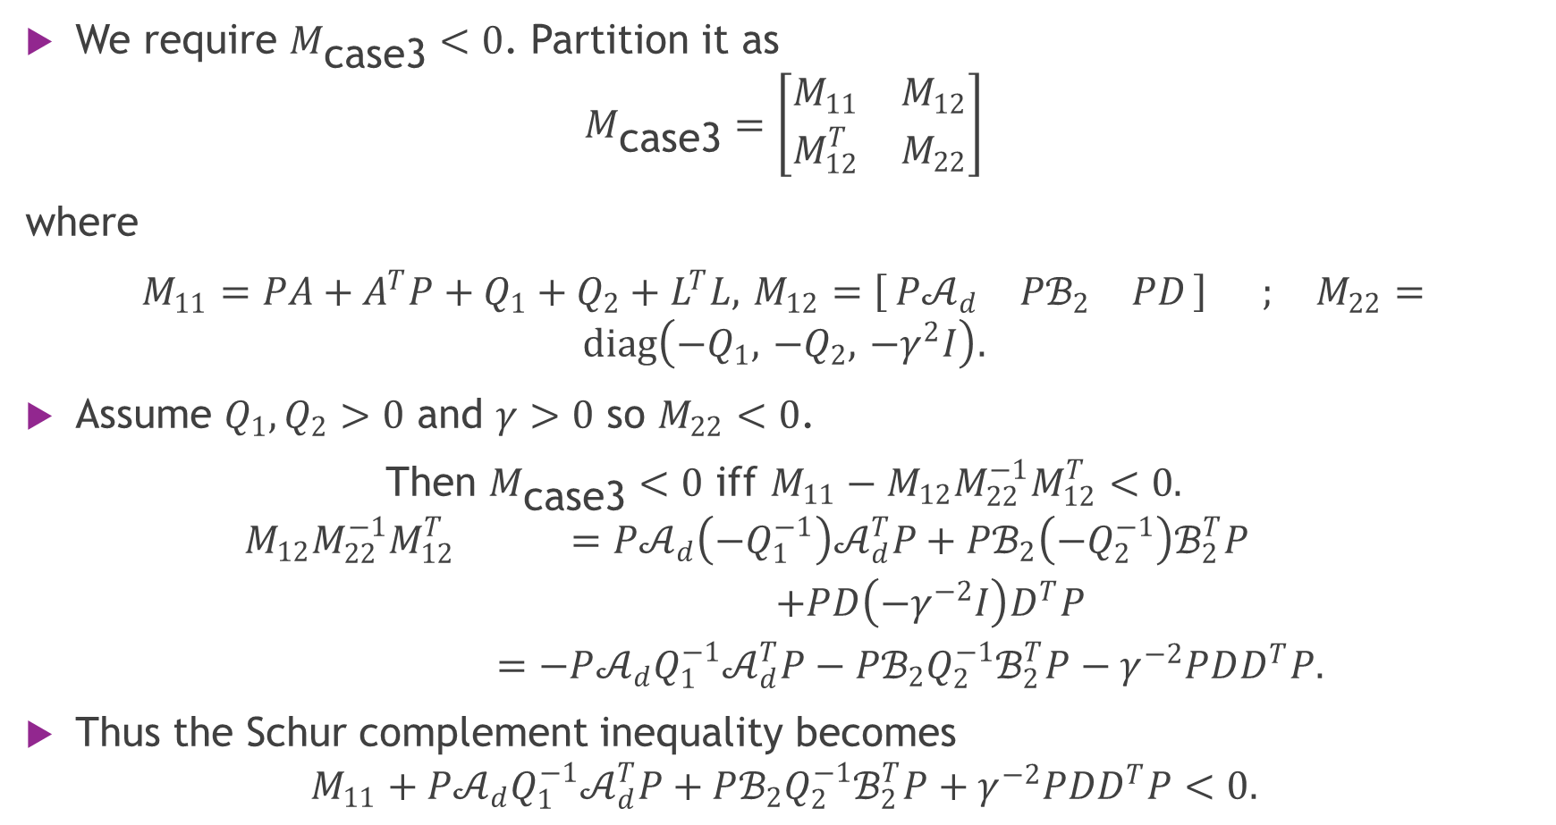
Schur complement of $M_{\text{case}\text{3}}$ → ARI (1/2)
We require $M_{\text{case}\text{3}}<0$. Partition it as
$$M_{\text{case}\text{3}}=\left[\begin{matrix}M_{11} & M_{12} \\ M_{12}^{T} & M_{22}\end{matrix}\right]$$
where
$M_{11}=PA+A^{T}P+Q_{1}+Q_{2}+L^{T}L,$ $M_{12}=\left[ P𝒜_{d} Pℬ_{2} PD \right] ; M_{22}=diag\left(−Q_{1}, −Q_{2}, −γ^{2}I\right).$
Assume $Q_{1},Q_{2}>0$ and $γ>0$ so $M_{22}<0$.
Then $M_{\text{case}\text{3}}<0$ iff $M_{11}−M_{12}M_{22}^{−1}M_{12}^{T}<0.$
$$\begin{matrix}M_{12}M_{22}^{−1}M_{12}^{T} & =P𝒜_{d}\left(−Q_{1}^{−1}\right)𝒜_{d}^{T}P+Pℬ_{2}\left(−Q_{2}^{−1}\right)ℬ_{2}^{T}P \\ & +PD\left(−γ^{−2}I\right)D^{T}P \\ & =−P𝒜_{d}Q_{1}^{−1}𝒜_{d}^{T}P−Pℬ_{2}Q_{2}^{−1}ℬ_{2}^{T}P−γ^{−2}PDD^{T}P.\end{matrix}$$
Thus the Schur complement inequality becomes
$$M_{11}+P𝒜_{d}Q_{1}^{−1}𝒜_{d}^{T}P+Pℬ_{2}Q_{2}^{−1}ℬ_{2}^{T}P+γ^{−2}PDD^{T}P<0.$$

Slide 16


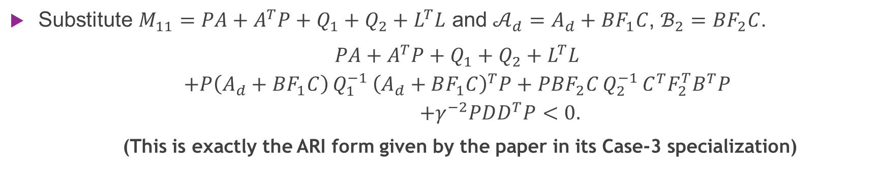
Schur complement of $M_{\text{case}\text{3}}$ → ARI (2/2)
Substitute $M_{11}=PA+A^{T}P+Q_{1}+Q_{2}+L^{T}L$ and $𝒜_{d}=A_{d}+BF_{1}C$, $ℬ_{2}=BF_{2}C$.
$\begin{matrix} & PA+A^{T}P+Q_{1}+Q_{2}+L^{T}L \\ & +P\left(A_{d}+BF_{1}C\right) Q_{1}^{−1} {\left(A_{d}+BF_{1}C\right)}^{T}P+PBF_{2}C Q_{2}^{−1} C^{T}F_{2}^{T}B^{T}P \\ & +γ^{−2}PDD^{T}P<0.\end{matrix}$
  (This is exactly the ARI form given by the paper in its Case-3 specialization)
Expand the merged quadratic term explicitly (for clarity)
$$\begin{matrix} & \underset{Φ_{0}}{\underset{⏟}{PA+A^{T}P+Q_{1}+Q_{2}+L^{T}L+PA_{d}Q_{1}^{−1}A_{d}^{T}P+γ^{−2}PDD^{T}P}} \\ & +\underset{\text{linear} \text{in} F_{1}}{\underset{⏟}{PA_{d}Q_{1}^{−1}C^{T}F_{1}^{T}B^{T}P+PBF_{1}CQ_{1}^{−1}A_{d}^{T}P}} \\ & +\underset{\text{quadratic} \text{in} F_{1}}{\underset{⏟}{PBF_{1}CQ_{1}^{−1}C^{T}F_{1}^{T}B^{T}P}} \\ & +\underset{\text{quadratic} \text{in} F_{2}}{\underset{⏟}{PBF_{2}CQ_{2}^{−1}C^{T}F_{2}^{T}B^{T}P}}<0.\end{matrix}$$

Slide 17
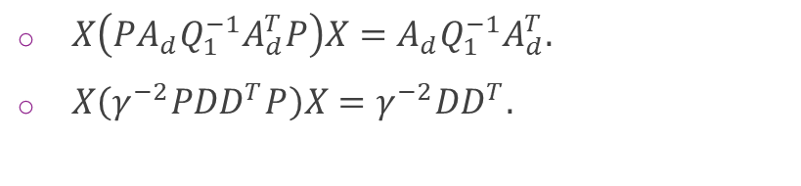

Left and right multiply by $X=P^{−1}$ (linearization)
Multiply (5.1) on left and right by $X$. Use $XP=I$. Term-wise:
  $X\left(PA+A^{T}P\right)X=AX+XA^{T}.$
  $X\left(Q_{1}+Q_{2}\right)X=XQ_{1}X+XQ_{2}X$
  $XL^{T}LX=XL^{T}LX$.
For controller quadratic terms:
$$X\left(PBF_{2}CQ_{2}^{−1}C^{T}F_{2}^{T}B^{T}P\right)X=BF_{2}CQ_{2}^{−1}C^{T}F_{2}^{T}B^{T}.$$
For the merged terms the cross terms linear in $F_{1}$ become objects like $A_{d}Q_{1}^{−1}C^{T}F_{1}^{T}B^{T}$ (independent of $P$ after multiplication).
So after multiplication we have (paper Eq.(20) specialized):
$$\begin{matrix}AX+XA^{T} & +X\left(Q_{1}+Q_{2}\right)X+XL^{T}LX \\ & +A_{d}Q_{1}^{−1}A_{d}^{T} \\ & +A_{d}Q_{1}^{−1}C^{T}F_{1}^{T}B^{T}+BF_{1}CQ_{1}^{−1}A_{d}^{T} \\ & +BF_{1}CQ_{1}^{−1}C^{T}F_{1}^{T}B^{T}+BF_{2}CQ_{2}^{−1}C^{T}F_{2}^{T}B^{T} \\ & +γ^{−2}DD^{T}<0.\end{matrix}$$
$X\left(PA_{d}Q_{1}^{−1}A_{d}^{T}P\right)X=A_{d}Q_{1}^{−1}A_{d}^{T}.$
$X\left(γ^{−2}PDD^{T}P\right)X=γ^{−2}DD^{T}.$

Slide 18
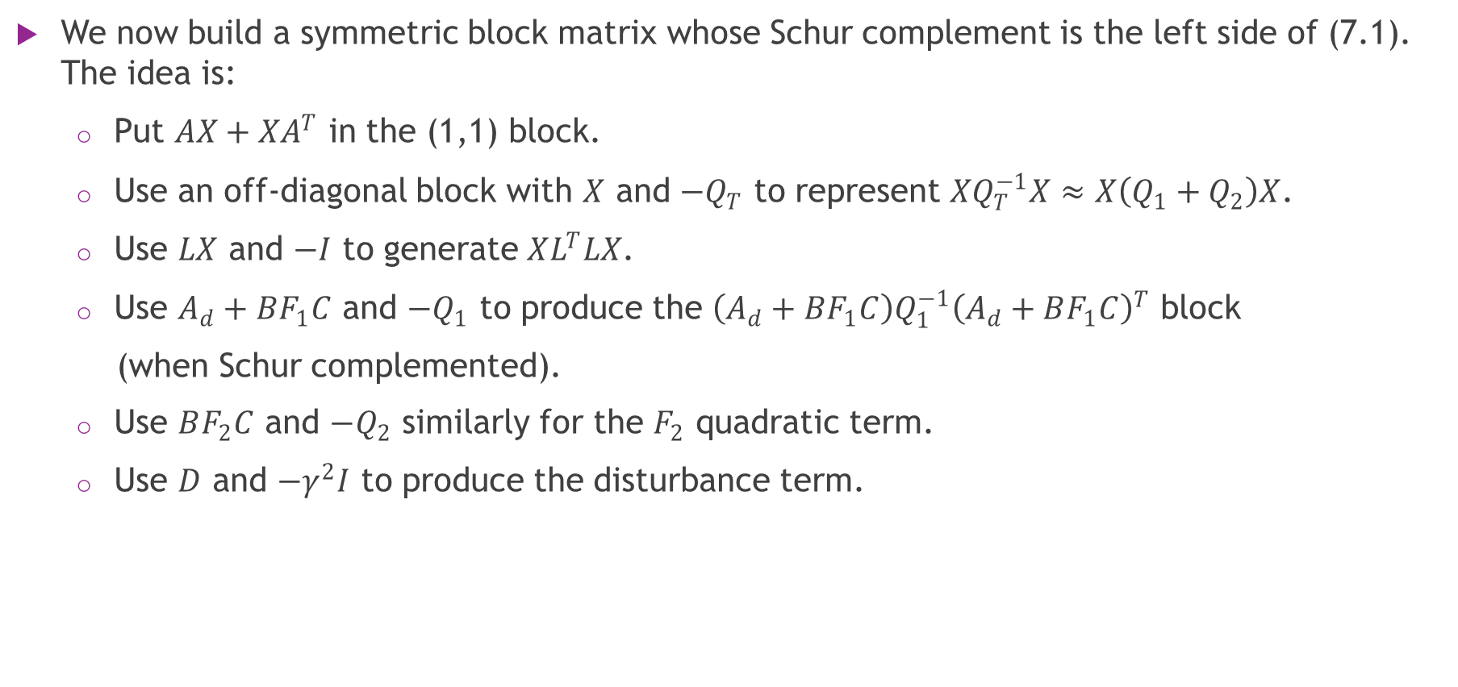
Reverse Schur complement → Final LMI (1/3)
We now build a symmetric block matrix whose Schur complement is the left side of (7.1). The idea is:
  Put $AX+XA^{T}$ in the (1,1) block.
  Use an off-diagonal block with $X$ and $−Q_{T}$ to represent $XQ_{T}^{−1}X≈X\left(Q_{1}+Q_{2}\right)X$.
  Use $LX$ and $−I$ to generate $XL^{T}LX$.
  Use $A_{d}+BF_{1}C$ and $−Q_{1}$ to produce the $\left(A_{d}+BF_{1}C\right)Q_{1}^{−1}{\left(A_{d}+BF_{1}C\right)}^{T}$ block
  (when Schur complemented).
  Use $BF_{2}C$ and $−Q_{2}$ similarly for the $F_{2}$ quadratic term.
  Use $D$ and $−γ^{2}I$ to produce the disturbance term.

Slide 19
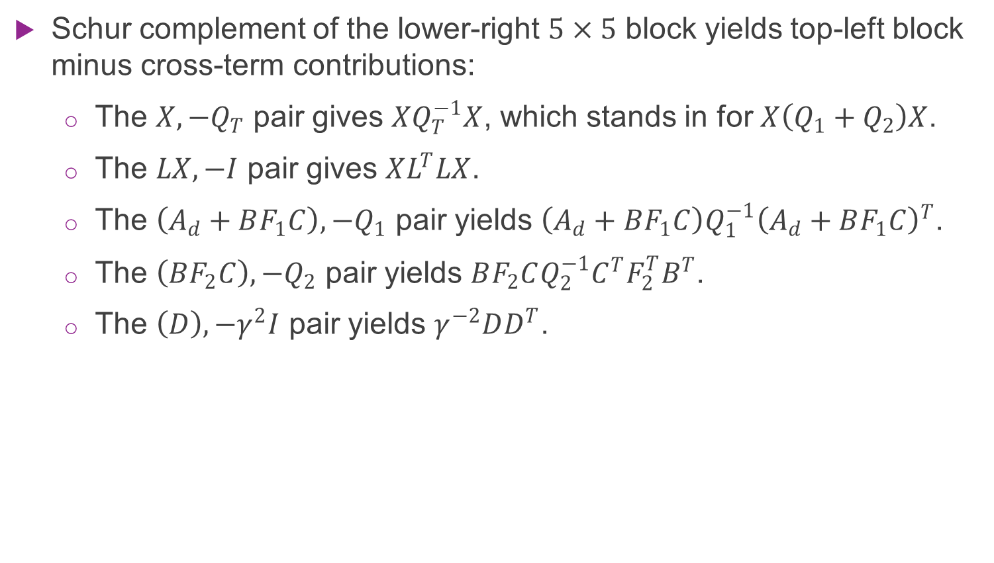
Reverse Schur complement → Final LMI (2/3)
Schur complement of the lower-right $5×5$ block yields top-left block minus cross-term contributions:
  The $X,−Q_{T}$ pair gives $XQ_{T}^{−1}X$, which stands in for $X\left(Q_{1}+Q_{2}\right)X$.
  The $LX,−I$ pair gives $XL^{T}LX$.
  The $\left(A_{d}+BF_{1}C\right),−Q_{1}$ pair yields $\left(A_{d}+BF_{1}C\right)Q_{1}^{−1}{\left(A_{d}+BF_{1}C\right)}^{T}$.
  The $\left(BF_{2}C\right),−Q_{2}$ pair yields $BF_{2}CQ_{2}^{−1}C^{T}F_{2}^{T}B^{T}$.
  The $\left(D\right),−γ^{2}I$ pair yields $γ^{−2}DD^{T}$.

Slide 20
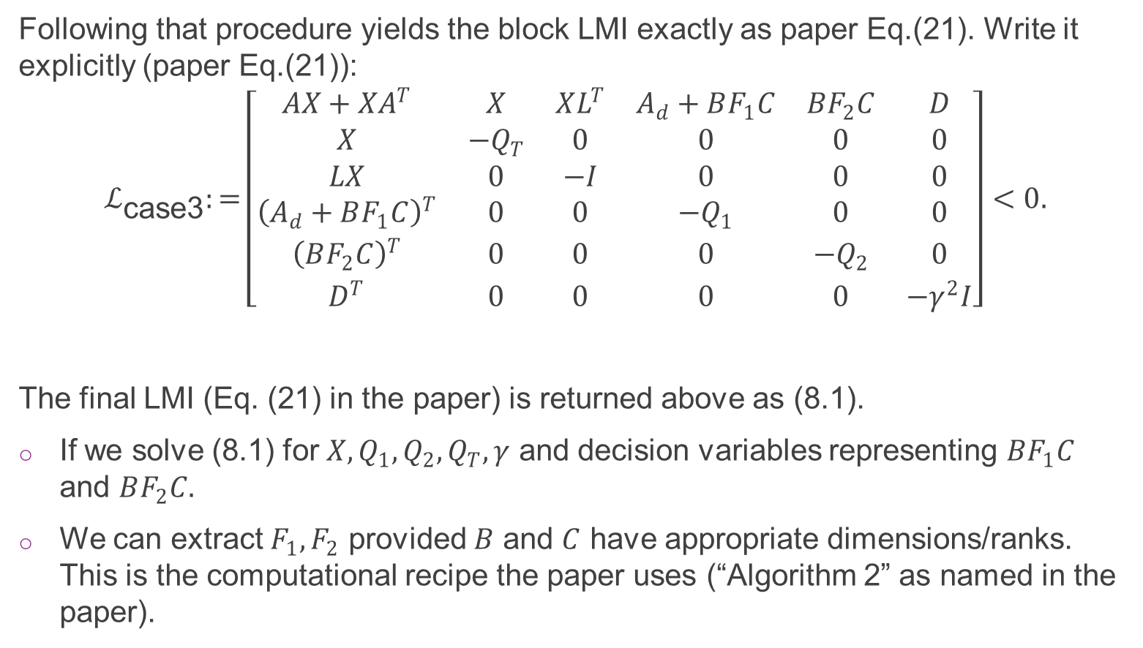
Reverse Schur complement → Final LMI (3/3)
Following that procedure yields the block LMI exactly as paper Eq.(21). Write it explicitly (paper Eq.(21)):
$$ℒ_{\text{case}\text{3}}:=\left[\begin{matrix}AX+XA^{T} & X & XL^{T} & A_{d}+BF_{1}C & BF_{2}C & D \\ X & −Q_{T} & 0 & 0 & 0 & 0 \\ LX & 0 & −I & 0 & 0 & 0 \\ {\left(A_{d}+BF_{1}C\right)}^{T} & 0 & 0 & −Q_{1} & 0 & 0 \\ {\left(BF_{2}C\right)}^{T} & 0 & 0 & 0 & −Q_{2} & 0 \\ D^{T} & 0 & 0 & 0 & 0 & −γ^{2}I\end{matrix}\right]<0.$$
The final LMI (Eq. (21) in the paper) is returned above as (8.1).
If we solve (8.1) for $X,Q_{1},Q_{2},Q_{T},γ$ and decision variables representing $BF_{1}C$ and $BF_{2}C.$
We can extract $F_{1},F_{2}$ provided $B$ and $C$ have appropriate dimensions/ranks. This is the computational recipe the paper uses (“Algorithm 2” as named in the paper).

Slide 21

Simulation Setup
Environment: MATLAB / Simulink.
Parameters:
  Network Load ($N$): 1200 TCP flows.
  Link Capacity ($C_{o}$): 25,000 packets/s.
  Propagation Delay ($T_{P}$): 0.2 s (200 ms).
  Operating Point (Queue, $q_{o}$): 500 packets.
  Operating Point (Window, $W_{o}$): 5 packets.
  Operating Point (Probability, $p_{o}$): 0.0952.
  Max Buffer Size ($\overline{q}$): 800 packets.
  Max Window Size ($\overline{W}$): 20.
  Initial Conditions: Initial queue length and window size are zero.
  Noise: The propagation delay is randomized to simulate network jitter:
  ($T_{p}=\left(200+40ξ\right)$ ms, where $ξ$ is a uniform random variable on the interval [-0.5, 0.5].)
Speed of sound changes with gas composition. Solvent vapors can cause massive errors if the sensor assumes air.

Slide 22
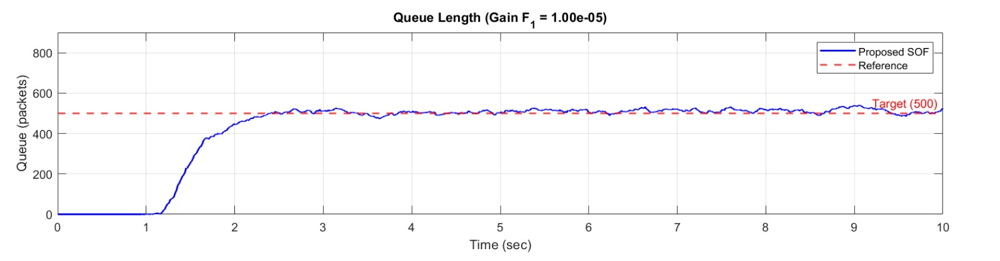
Reproduced Results - Queue Length
Results:
  Queue rises and stabilizes at the Target (500 packets).
  Rise Time: ~1.67 seconds
  Performance: No overshoot; critically damped response.

Slide 23
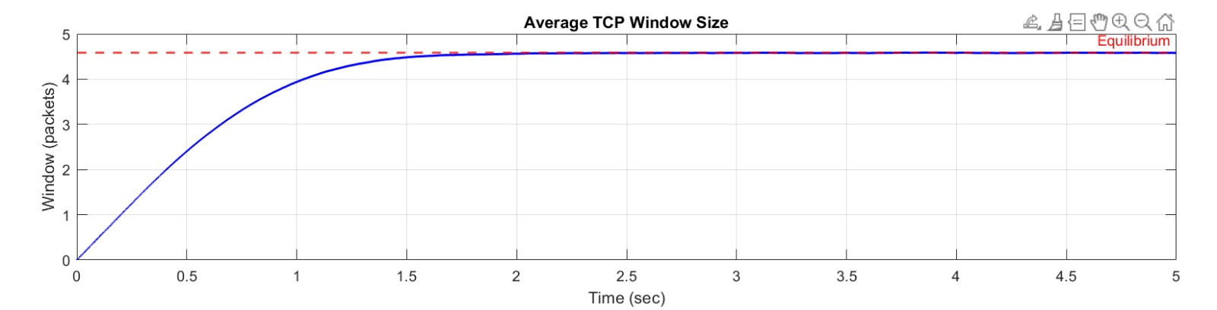
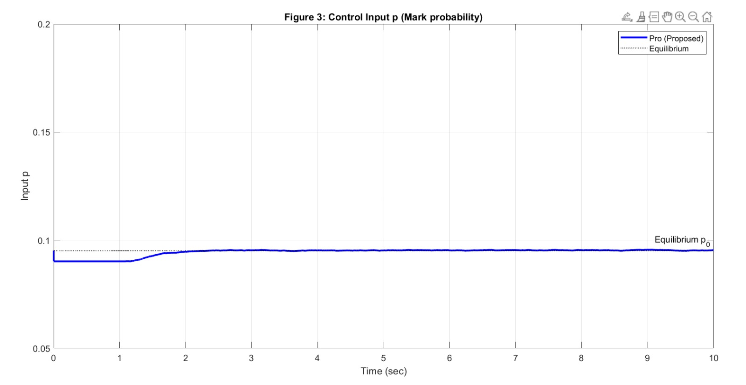
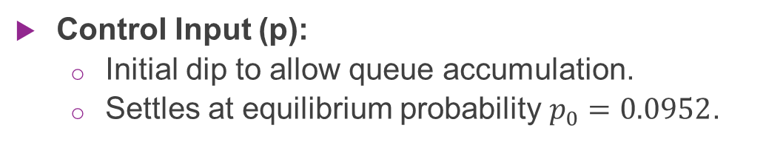
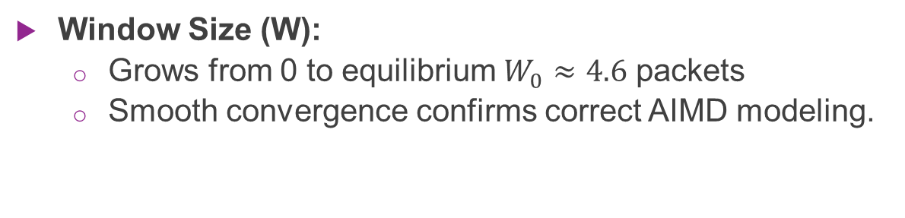
Reproduced Results - Window & Input
Window Size (W):
  Grows from 0 to equilibrium $W_{0}≈4.6$ packets
  Smooth convergence confirms correct AIMD modeling.
Control Input (p):
  Initial dip to allow queue accumulation.
  Settles at equilibrium probability $p_{0}=0.0952$.

Slide 24
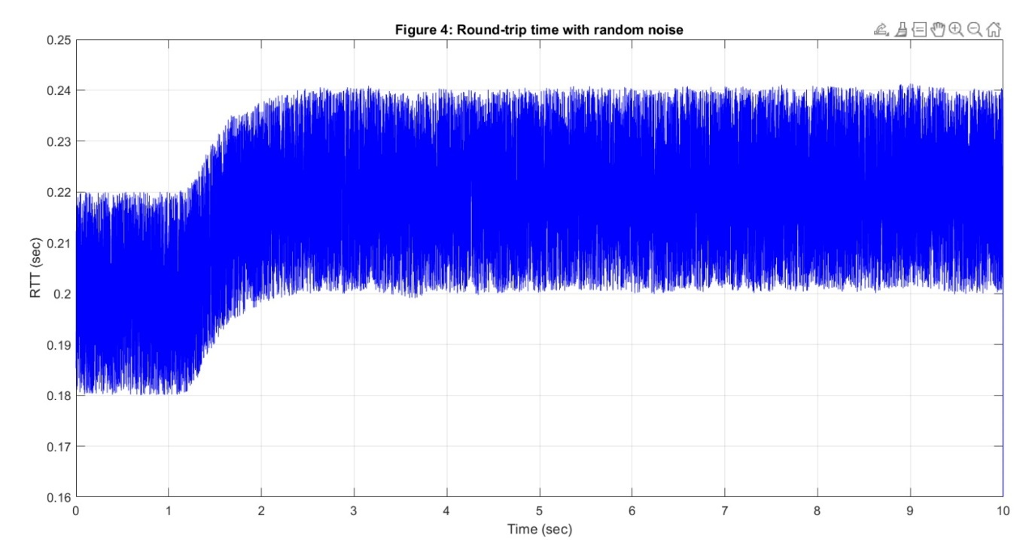
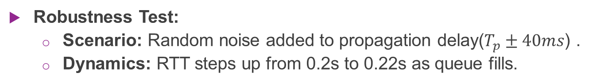
Reproduced Results - RTT & Robustness
Robustness Test:
  Scenario: Random noise added to propagation delay($T_{p}±40ms$) .
  Dynamics: RTT steps up from 0.2s to 0.22s as queue fills.
Outcome:
  The system remains stable despite significant jitter.
  Validates the Delay-Independent stability property.

Slide 25
Discussion & Validation (1/5)
These graphs are Histograms. They don't show time; they show frequency (how many of the 50 runs landed in a specific range).
Monte Carlo Peak Queue Length
What it shows: The highest queue value reached during the transient phase (the initial spike).
Analysis:
  The bars are clustered between 525 and 535 packets.
  The absolute worst-case scenario (far right bar) was about 545 packets.
  Conclusion: This is excellent. The buffer limit is 800 packets. Since the worst-case peak (545) is far below 800, your controller is Safe. It will not overflow even with random noise.

Slide 26
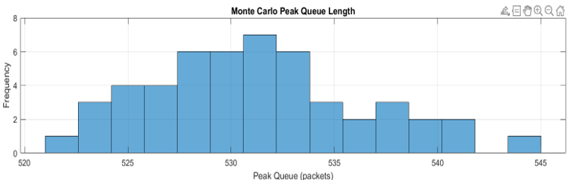
Discussion & Validation (2/4)

Slide 27
Discussion & Validation (3/5)
Monte Carlo Steady-State Queue
What it shows: Where the queue settled down after the simulation finished (the accuracy).
Analysis:
  The Target is 500 packets.
  Most runs settled between 505 and 512 packets.
  The spread is small (about +/- 15 packets from target).
  Conclusion: This proves Precision. Even with constant random jitter in the network delay, the H-infinity controller keeps the queue very close to the target of 500. It doesn't drift away.

Slide 28
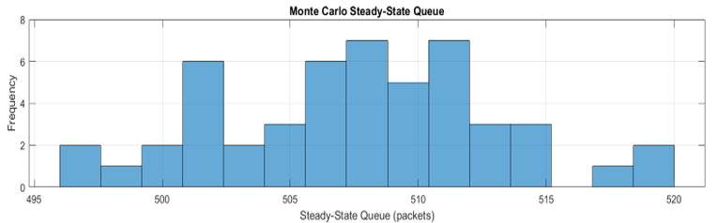
Discussion & Validation (4/5)

Slide 29
Discussion & Validation (5/5)
Reproduction Success:
  MATLAB simulation accurately implements the "Case 3" nonlinear system.
  Requirement: Trajectories for Queue, Window, and RTT are visually and numerically identical to the reference paper's "Pro" results.
Key Validation:
  Confirmed stability without full-state information.
  Confirmed robustness against link capacity disturbances.

Slide 30
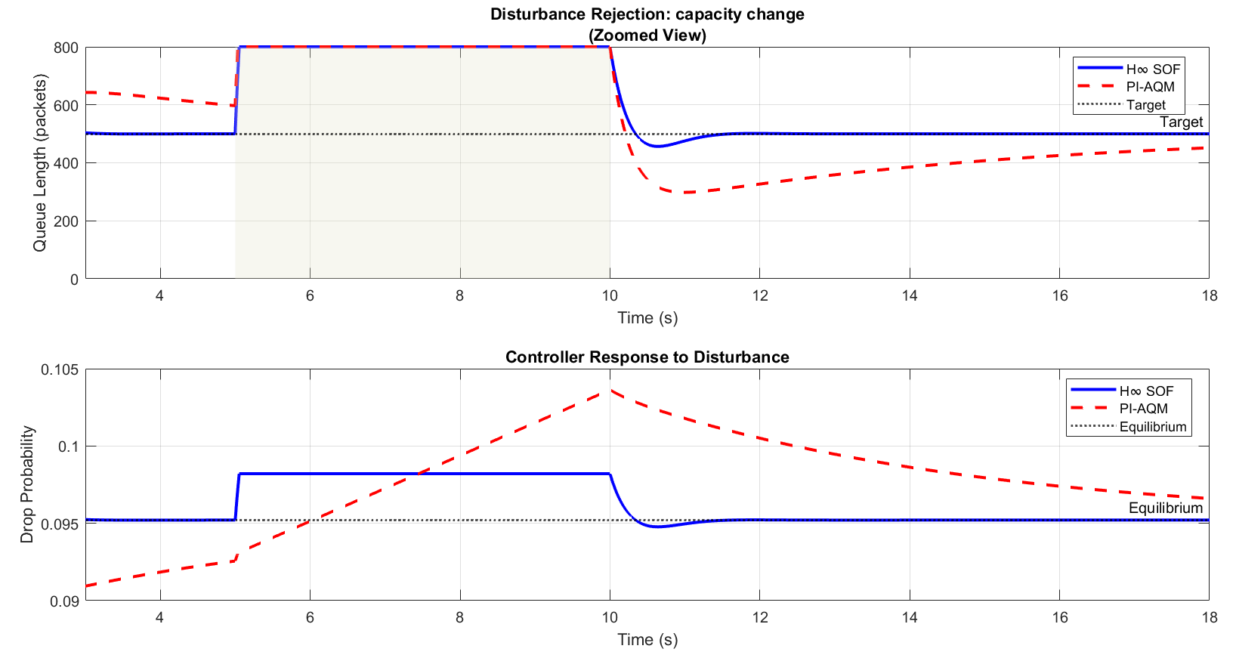
Extension: H infinity SOF AQM vs PI AQM

Slide 31

Conclusion
Summary:
  MATLAB Reproduced an $H_{\text{∞}}$SOF controller for TCP/AQM routers.
  Validated the theoretical LMI conditions for Case 3 (h = d).
  Demonstrated effective stabilization and disturbance rejection.
Impact:
  Provides a practical, low-complexity solution for high-speed routers
  In conclusion, we have successfully implemented and validated a robust controller that is both effective and simple enough for real-world application. It stabilizes the queue and rejects disturbances using only local measurements.
Notes:
In conclusion, we have successfully implemented and validated a robust controller that is both effective and simple enough for real-world application. It stabilizes the queue and rejects disturbances using only local measurements.

Slide 32

Any Questions?

